Slide 1
Stage 5, Bay 6 Takeshi's Castle Course Designer: Eric Beerbaum
Takeshi’s Castle is a 40 round unlimited course. There are 10 paper targets and 20 poppers. Paper must be neutralized and steel must fall to score. The start signal is audible.
The Handgun start position is standing with toes touching start stick and wrists below belt. Handgun loaded and holstered. If you do not have a holster, the pistol will be loaded and placed on barrel 1. The PCC start position is standing with toes touching start stick. PCC loaded, safety on, stock touching belt.
On the audible start signal, engage targets from within the shooting areas. Red Steel must be shot from respective boxes.

Slide 2
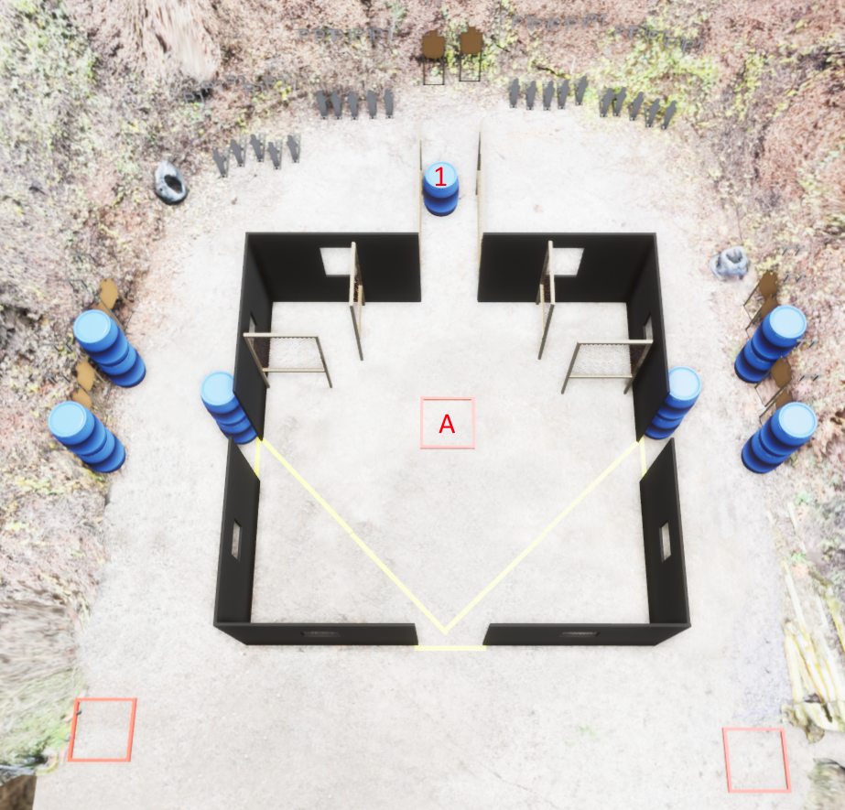
 | Stage 5, Bay 6 Takeshi's Castle Course Designer: Eric Beerbaum

